Slide 1

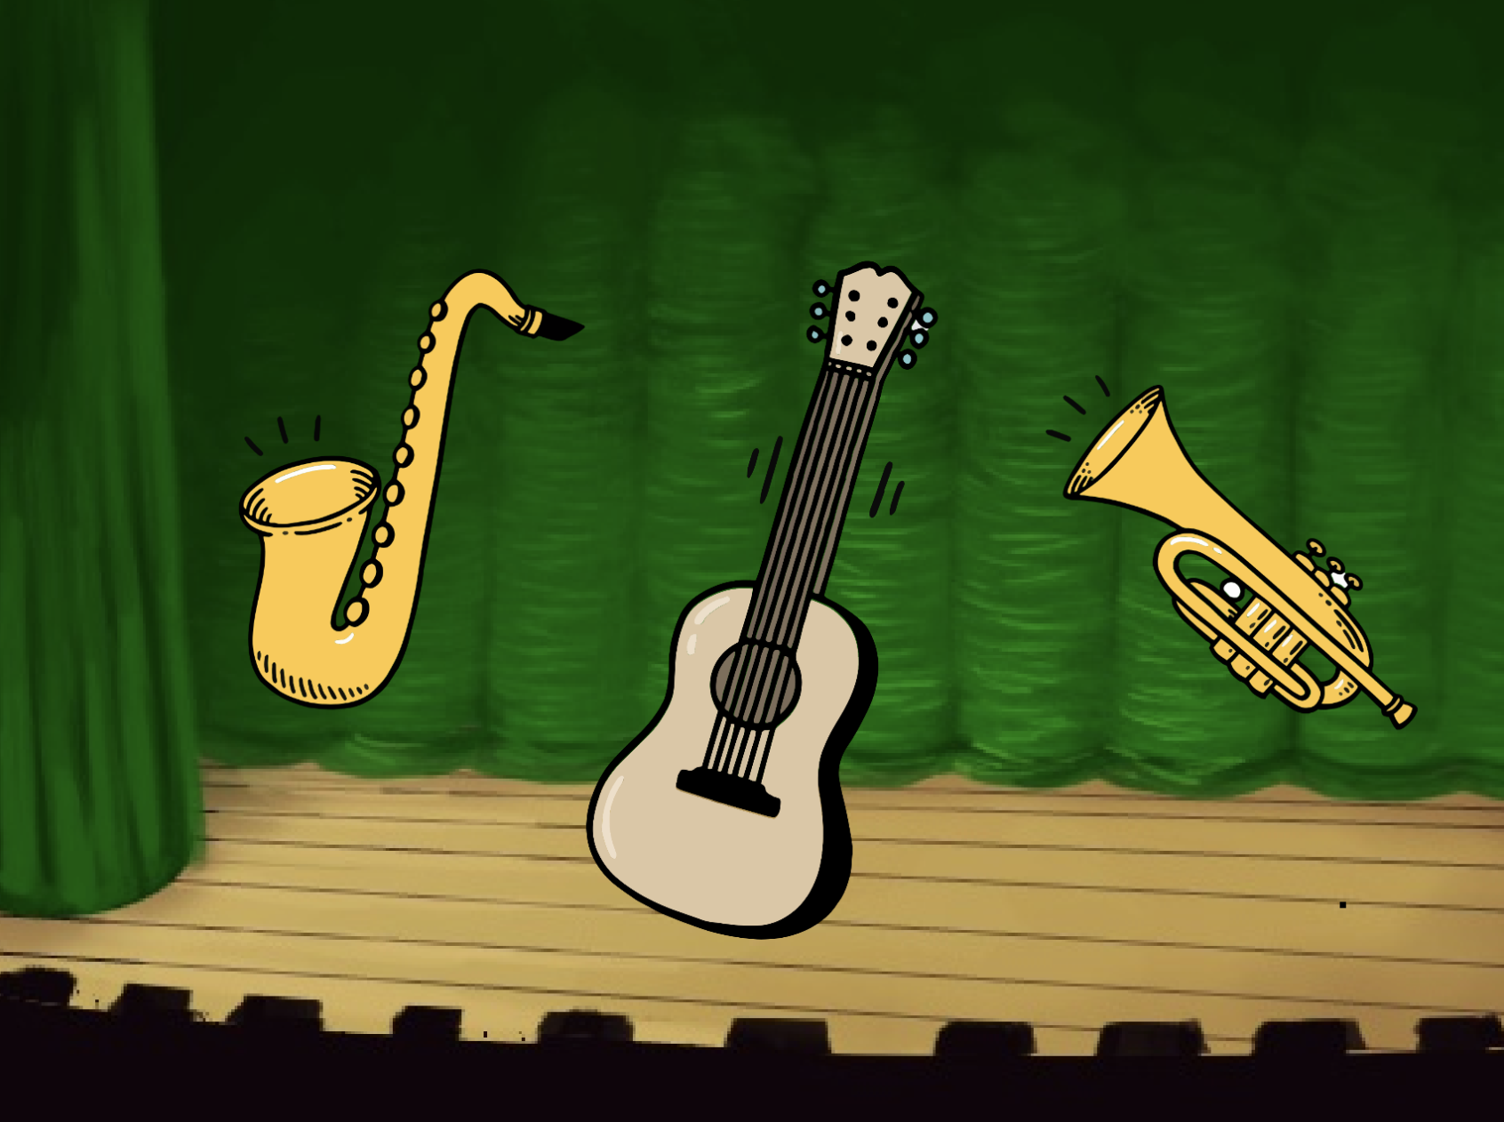
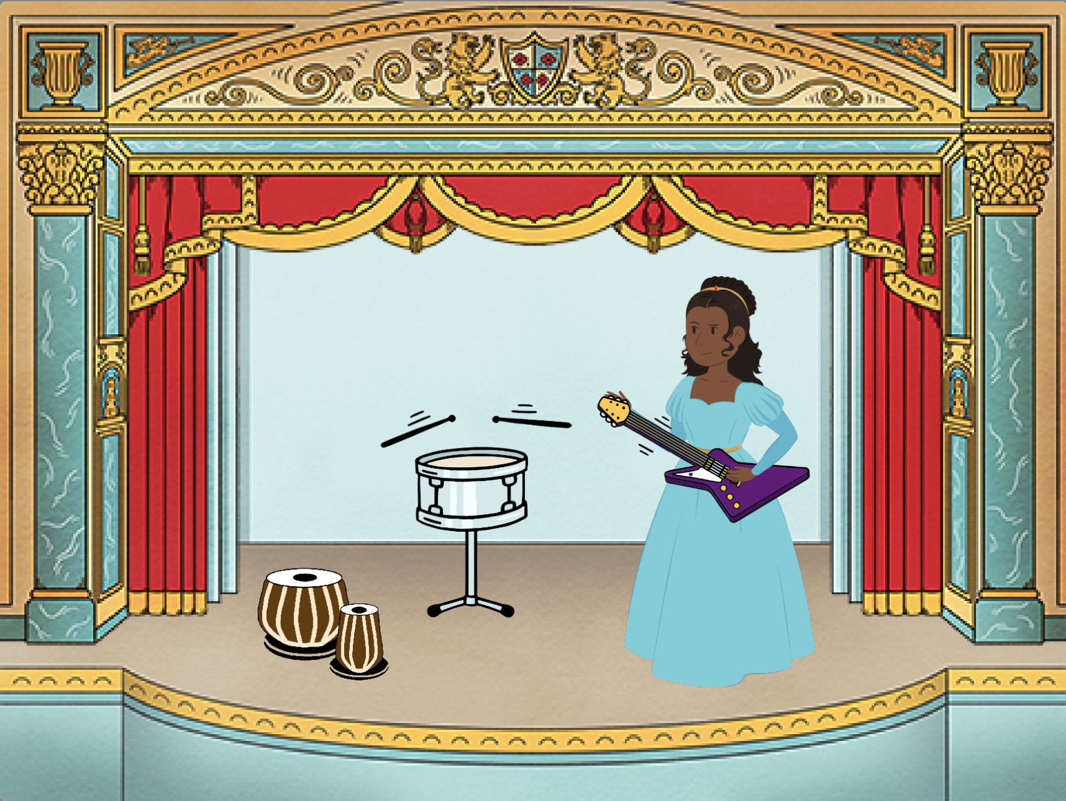
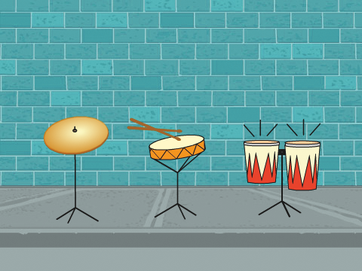
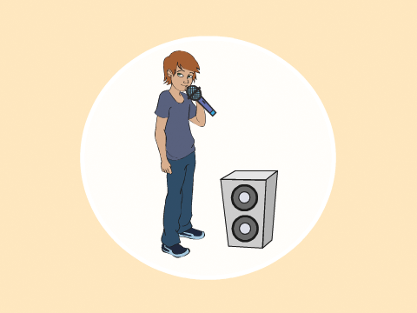


Make Music Cards
Choose instruments, add sounds, and press keys to play music.
scratch.mit.edu
Set of 9 cards

Slide 2
Make Music Cards
Try these cards in any order:
Play a Drum
Make a Rhythm
Animate a Drum
Make a Melody
Play a Chord
Surprise Song
Beatbox Sounds
Record Sounds
Play a Song
scratch.mit.edu
Set of 9 cards

Slide 3
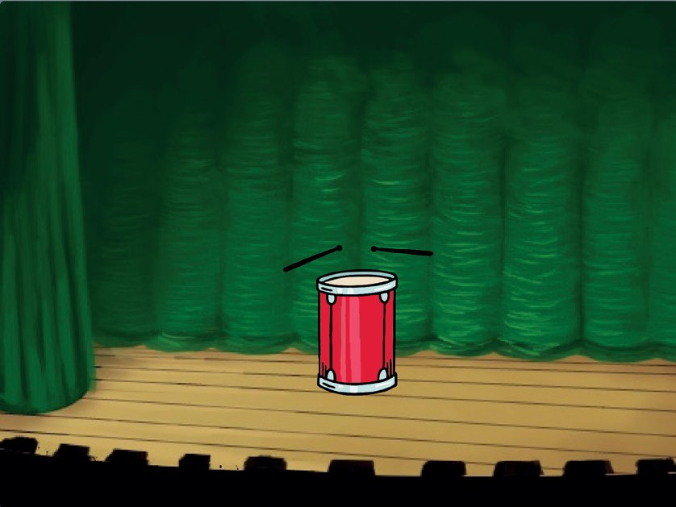

Play a Drum
Press a key to make a drum sound.
Make Music
1

Slide 4

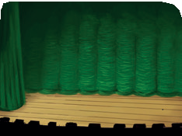

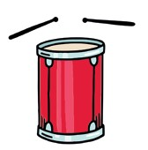
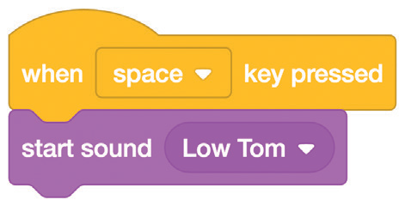
Play a Drum
scratch.mit.edu
GET READY
Choose a backdrop.
Theater 2
Choose a drum.
Drum
ADD THIS CODE
Select the sound you want from the menu.
TRY IT
Press the space key on your keyboard.

Slide 5
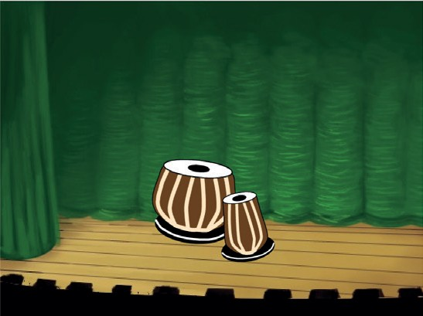
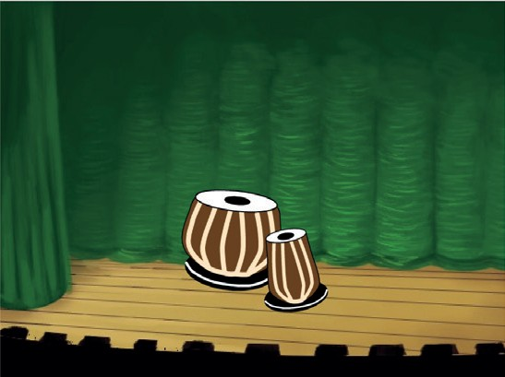
Make a Rhythm
Play a loop of repeating drum sounds.
Make Music
2

Slide 6

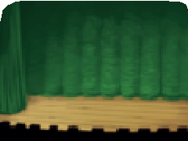



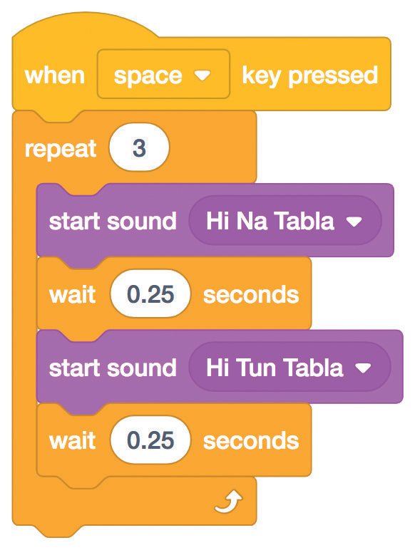
Make a Rhythm
scratch.mit.edu
GET READY
Choose a backdrop.
Theater 2
Choose a drum from the Music category.
Drum Tabla
To see just the music sprites, click the Music
category at the top of the Sprite Library.
ADD THIS CODE
Type how many times you want to repeat.
Try different numbers to change the rhythm.
TRY IT
Press the space key on your keyboard.

Slide 7
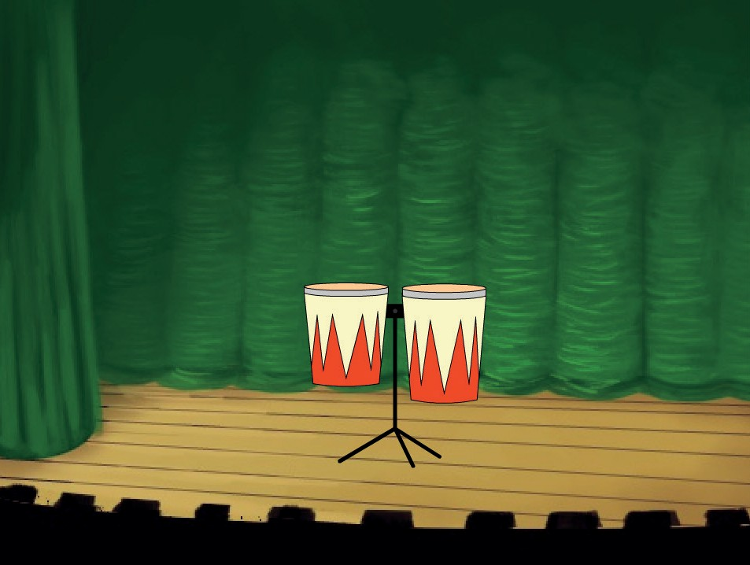
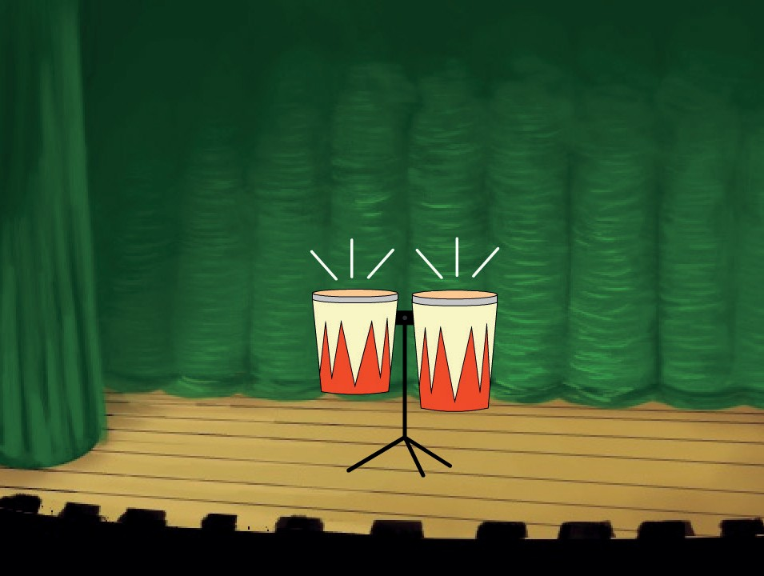
Animate a Drum
Switch between costumes to animate.
Make Music
3

Slide 8


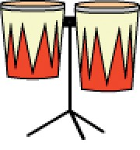
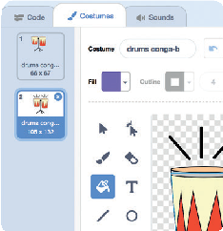

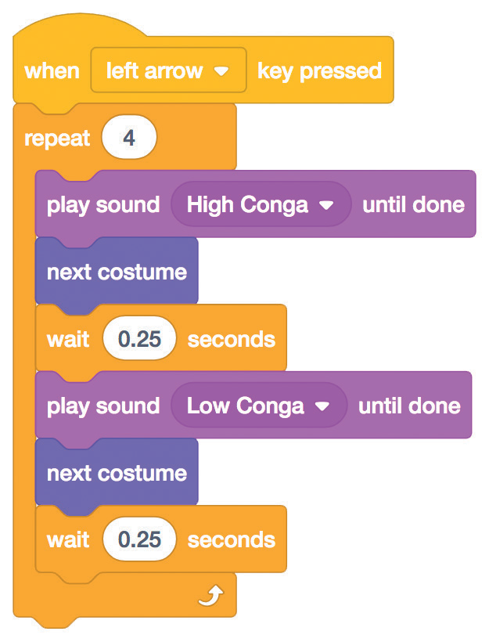

Animate a Drum
scratch.mit.edu
GET READY
Click the Costumes tab to see the costumes.
Choose a drum.
Drum Conga
You can use the paint tools to change colors.
ADD THIS CODE
Click the Code tab.
Choose a sound from the menu.
TRY IT
Press the left arrow key on your keyboard.

Slide 9
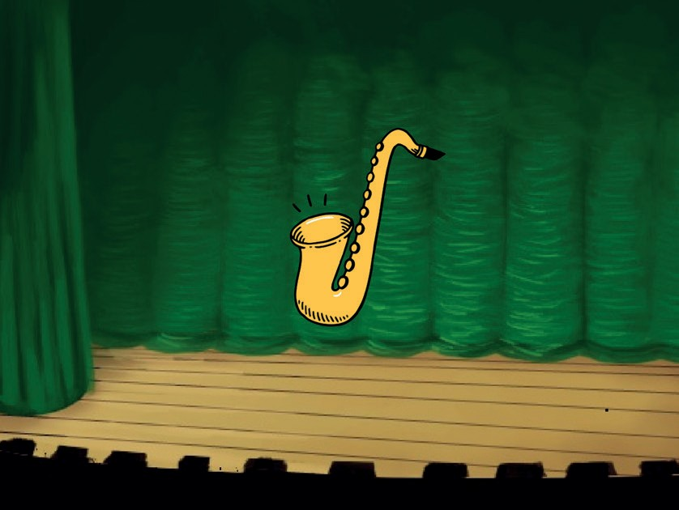
Make a Melody
Play a series of notes.
Make Music
4

Slide 10


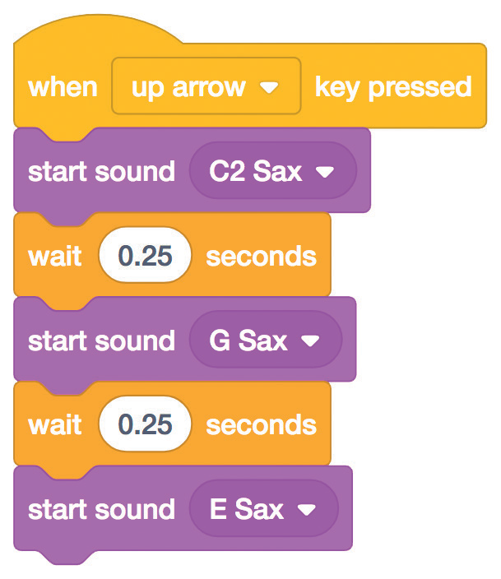

Make a Melody
scratch.mit.edu
GET READY
Choose an instrument, like Saxophone.
Saxophone
To see just the music sprites, click the Music category at the top of the Sprite Library.
ADD THIS CODE
Choose up arrow
(or another key).
Choose different sounds.
TRY IT
Press the up arrow key.

Slide 11
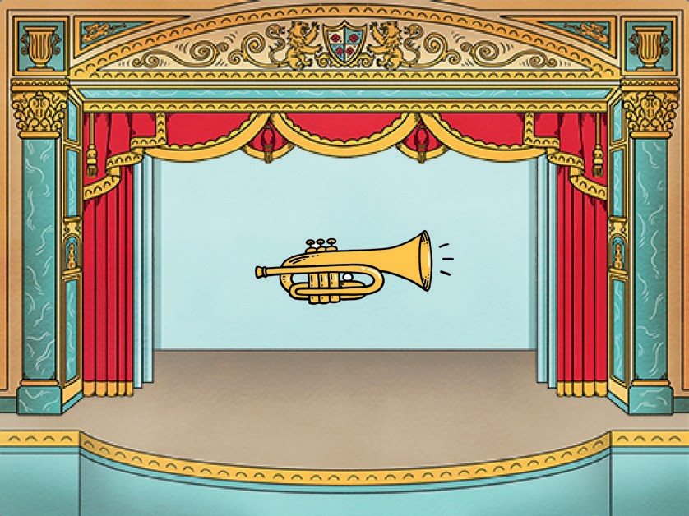
Play a Chord
Play more than one sound at a time to make a chord.
Make Music
5

Slide 12


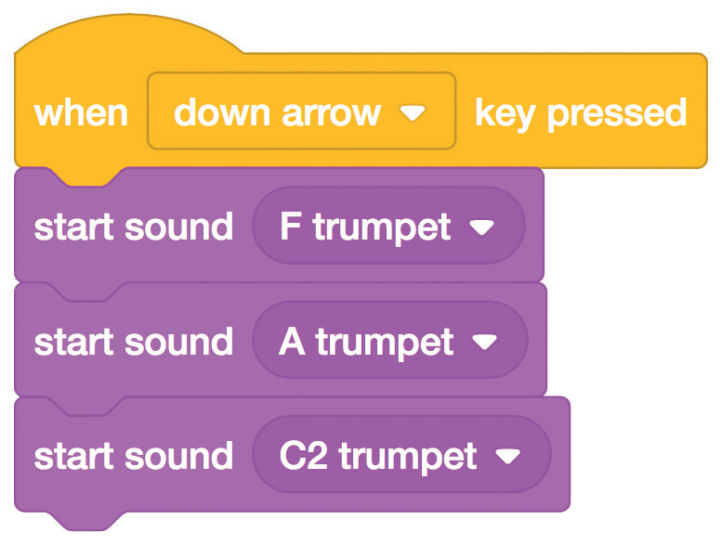

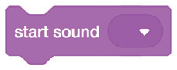
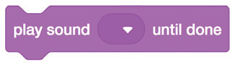
Play a Chord
scratch.mit.edu
GET READY
Choose an instrument, like Trumpet.
To see just the music sprites, click the Music category at the top of the Sprite Library.
Trumpet
ADD THIS CODE
Choose down arrow
(or another key).
Choose different sounds.
TRY IT
Press the down arrow key.
TIP
Use
to play sounds play at the same time.
Use
to play sounds one after another.

Slide 13
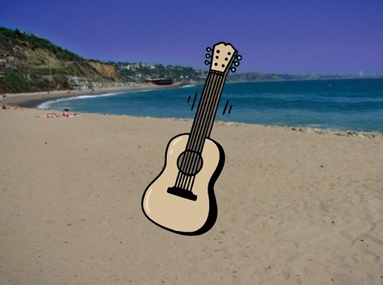
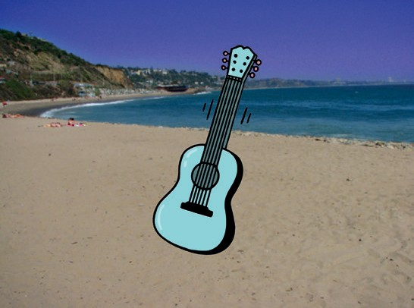
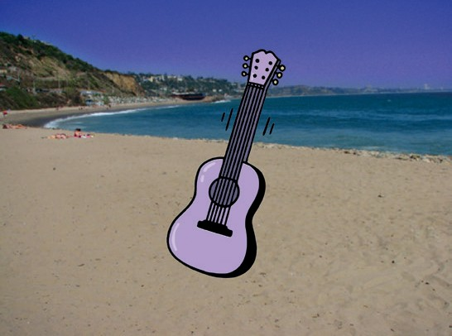
Surprise Song
Play a random sound from a list of sounds.
Make Music
6

Slide 14


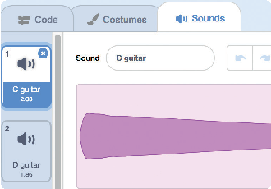
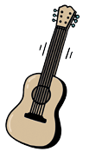

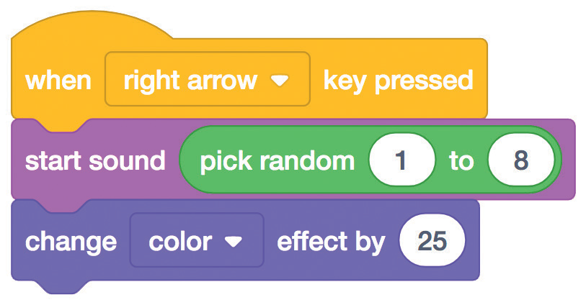

Surprise Song
scratch.mit.edu
GET READY
Click the Sounds tab to see how many sounds are in your instrument.
Choose and instrument, like Guitar.
Guitar
ADD THIS CODE
Click the Code tab.
Choose right arrow.
Insert a pick random block.
Type the number of sounds in your instrument.
TRY IT
Press the right arrow key.

Slide 15
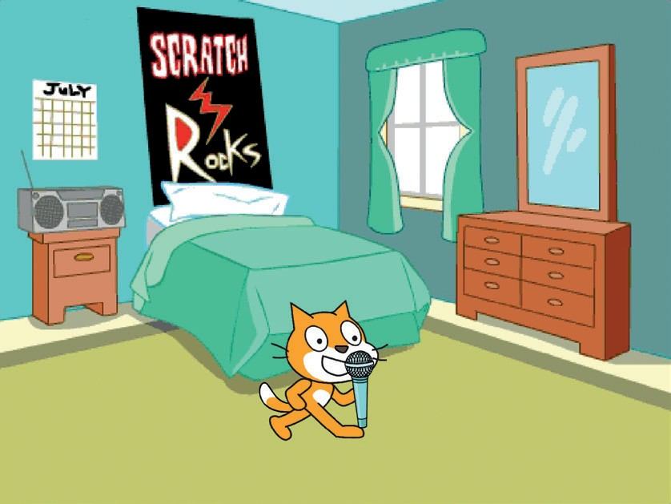
Beatbox Sounds
Play a series of vocal sounds.
Make Music
7

Slide 16

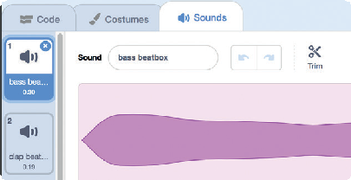
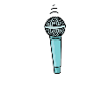

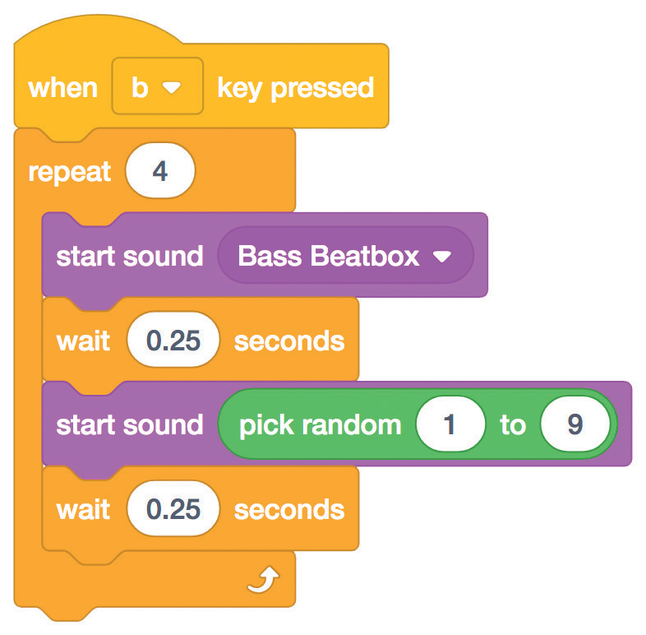

Beatbox Sounds
scratch.mit.edu
GET READY
Click the Sounds tab to see how many sounds are in your instrument.
Choose the Microphone sprite.
Microphone
ADD THIS CODE
Click the Code tab.
Choose b (or another key).
Insert a pick random block.
Type the number of sounds in this sprite.
TRY IT
Press the B key to start.

Slide 17
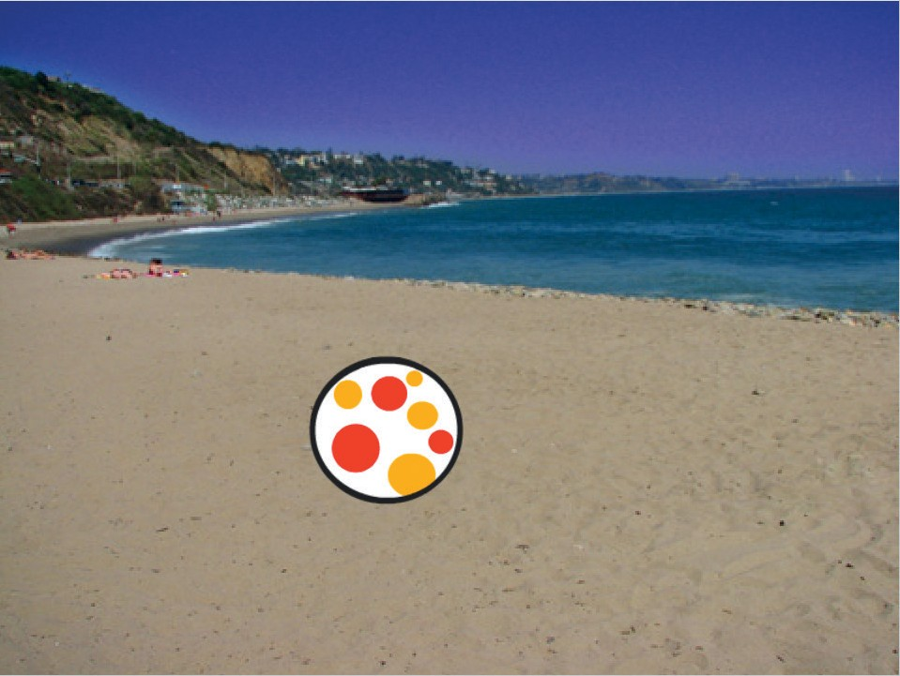
Record Sounds
Make your own sounds to play.
Make Music
8

Slide 18




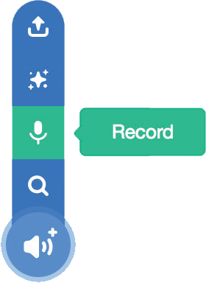
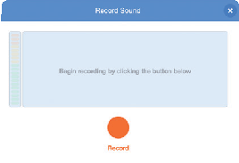


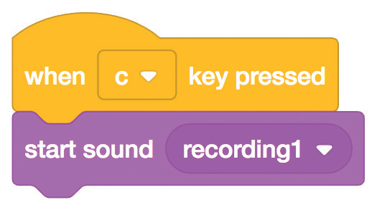

Record Sounds
scratch.mit.edu
GET READY
Choose a backdrop.
Beach Malibu
Choose any sprite.
Beachball
Click the Sounds tab.
Then choose Record
from the pop-up menu.
Click the Record button to record a short sound.
ADD THIS CODE
Click the Code tab.
Choose c
(or another key).
TRY IT
Press the C key to start.

Slide 19
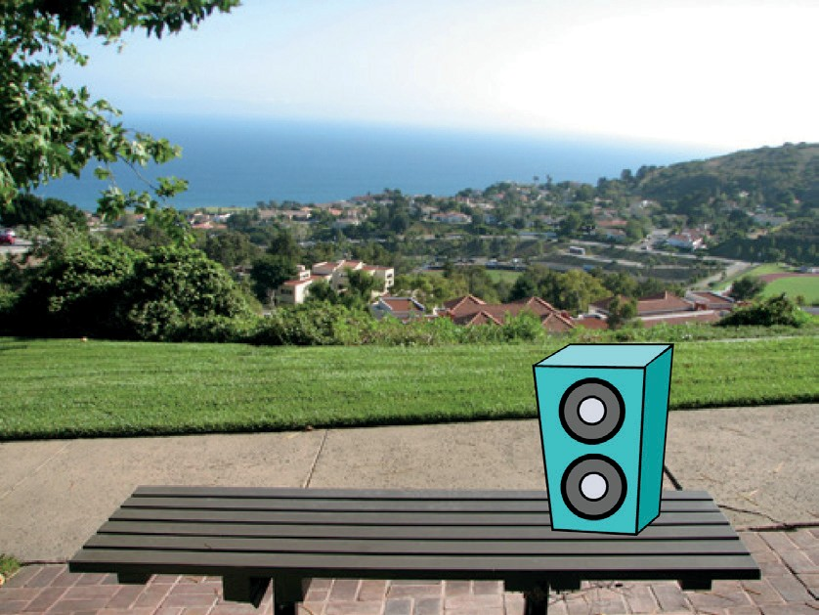
Play a Song
Add a music loop as background music.
Make Music
9

Slide 20

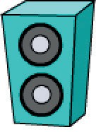

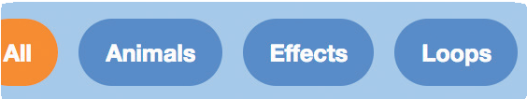

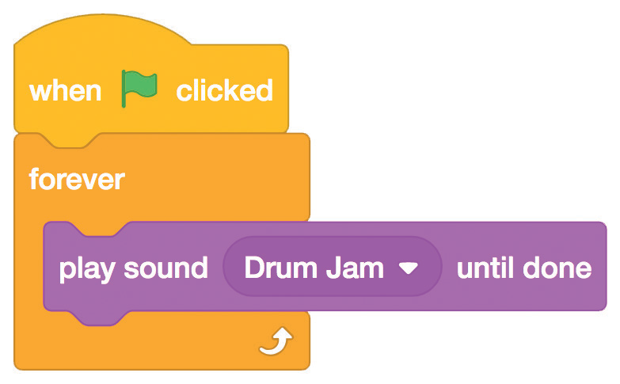
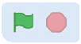
Play a Song
scratch.mit.edu
GET READY
Click the Sounds tab.
Choose a sound from the Loops category, like Drum Jam.
Choose a sprite, like Speaker.
Speaker
To see just the music loops, click the Loops
category at the top of the Sounds Library.
ADD THIS CODE
Click the Code tab.
Choose your sound from the menu.
TRY IT
Click the green flag to start.

